Slide 1
Top 8 Favorite Shows

Slide 2
Pretty Little Liars
Pretty Little Liars is a mystery, thriller, drama, and teen drama show
The 4 main characters are Hanna, Emily, Aria, and Spencer
The first ever episode was on June 8th 2010
It used to be about 5 girls but now its just 4. one girl named Allison was murdered and no one knows who did it
The 4 girls that remain are getting mysterious text messages about all their secrets and the person is signing the texts as “–A”

Slide 3
The Lying Game
The first ever episode was on August 15th 2011
It is a mystery, thriller, teen drama, action/adventure drama show
It is about 2 twin sisters Emma and Sutton
Emma and Sutton were both separated after their birth
They both want to discover what happened to their birth mother
Sutton went to Los Angeles to search for their birth mother and Emma has to pretend to be Sutton without getting caught

Slide 4
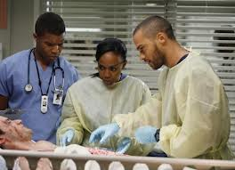
Grey’s Anatomy
First episode as on March 27th 2005
It is a medical drama
It is about many people who want to become surgeons
They are first interns then they become residents
It is also about their personal life and that comes into them trying to become surgeons

Slide 5
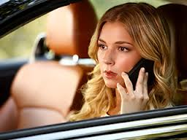
Revenge
First episode was on September 21st 2011
It is about a girl named Amanda and how her life was ruined by the Grayson's
The Grayson’s got Amanda’s father put in jail then murdered
Amanda is back and see is reading to destroy the Grayson’s life just like they destroyed hers
She has to keep her identity a secret so she pretend to be her friend Emily
She cant get caught…..

Slide 6
The Bachelor/Bachelorette
First episode was on March 25th 2002
It is about men and women who go on the bachelor to find love
24 men or women how to a house and fall in love with the bachelor/bachelorette
In the end of the show when there are 2 women/men left the bachelor/bachelorette propose to one women or men

Slide 7
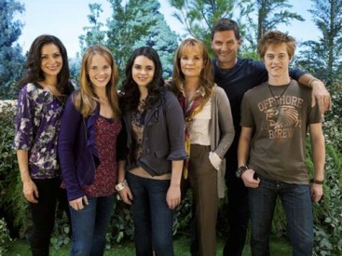
Switched at Birth
First episode was June 6th 2011
It is a drama show
It is basically 2 girls who accidently got switched at birth….
One girl is named Bay and the other girl is named Daphne
They both come together and try to live the life they were suppose to have with their real parents

Slide 8
The Vampire Diaries
The first episode was on September 10th 2009
It is about to men named Stefan and Damon
They are both vampires
They also love the same girl named Elena
There are also witches, werewolf's, and hybrids
Now everyone is on a hunt for a cure to make themselves human again
But there is only one cure….

Slide 9
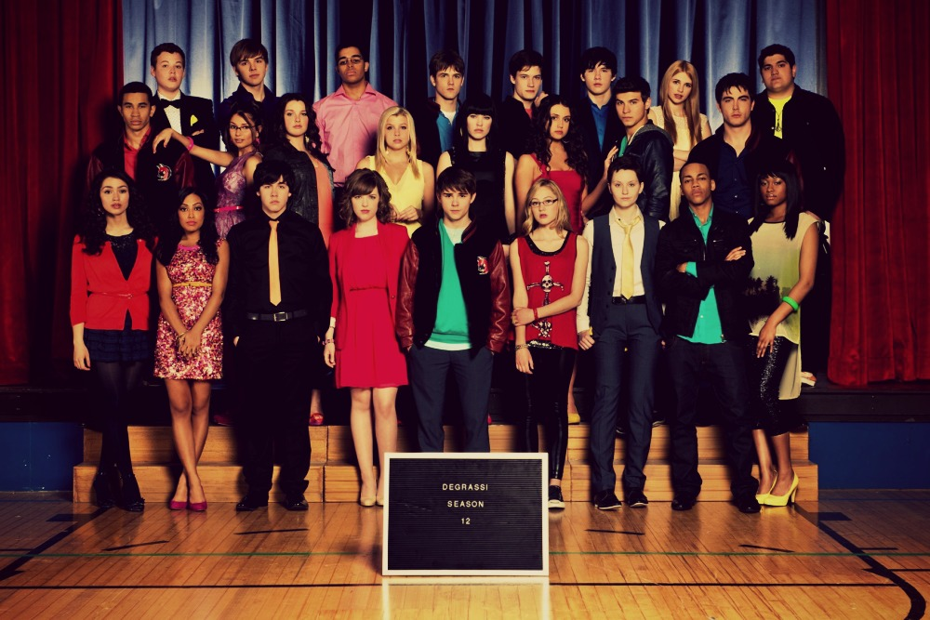
Degrassi
The first episode was on October 14th 2001
There are 12 seasons
It is about teens trying to get through high school
There are accidents, hockey jocks, a guy carrying a knife , police involved and so on

