Slide 1
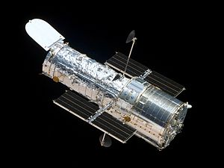
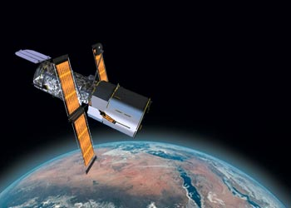
THE HUBBLE SPACE STATION
BY: Melanie and Ainsley

Slide 2
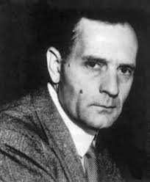
What is it? Purpose? Contributors?
What is it?
2.4 meter space telescope
Carried into orbit in 1990
Purpose:
Capture images in space
Shields us from radiation and allows us to live
Screens many wavelengths of radiation
Contributors:
Edwin Hubble- born in 1889 died in 1953
Michael Brown and Chadwick Trujillo discovered a new world beyond Pluto using the Hubble space telescope
NASA built it

Slide 3
What have we already learned? Benefits? Risks?
We have already learned about:
distant stars
new galaxies
new planets
Benefits:
incredibly vivid, detailed images of space
established a more accurate estimate of the age of the universe
shows the ways galaxies evolve
Risks:
batteries on the telescope may die
Needs lots of repairs

Slide 4
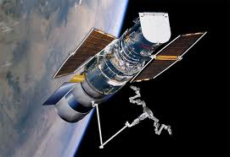
Plans for future use?
Telescope will continue to collect information and report back to NASA
NASA is working on another space telescope- the James Webb space telescope
Will approximately function until 2013 or longer

Slide 5
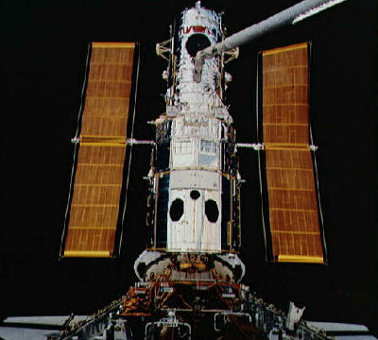
Plans for improvements?
Replacing the batteries every 18-20 years
2009 last repair and update
New equipment

Slide 6
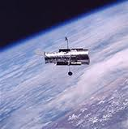
THANK YOU FOR LISTENING

