Slide 1
Trans Fat
By: Krista, Melanie, Julea, and Kaelin

Slide 2
Sources of trans fat
Most of trans fat can come from margarines ( especially hard margarines) , fried foods, bakery product ( made with shortening, margarine or oils ) Also these products include crackers, cookies, donuts, cakes, pastries, muffins, crosscuts, and lots of breaded foods
A lot of trans fat in these foods have been reduced in the previous years

Slide 3
Functions of Trans Fat in the body
It can raise LDL ( bad cholesterol ) and can lower good cholesterol ( LDL is a risk factor for heart disease )
Trans fat is artificially made to extend the shelf life of foods. This means the food wont go as bad as quickly, if it contains trans fat

Slide 4
Recommended daily value
- There is no recommended daily value of trans fat because it increases coronary heart disease
- Overall you do not want to have much of trans fat in your diet

Slide 5
What happens if you consume to much/little
You shouldn’t consume a lot of trans fat because you increase your risk of getting coronary heart disease
You will be a lot healthier and in better shape if you don’t consume much trans fat

Slide 6
Historical information
German chemist Cilhelm Normann built a fat-hardening facility in 1905- 1910
in 1911 they made the first hydrogenated shortening called Criscol.

Slide 7
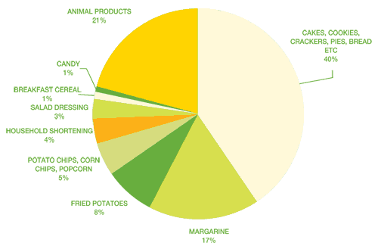
facts about trans fat
Trans fatty acids is known as trans fat

Slide 8
Recipes
Recipe #1 Deep fried donuts
Ingredients: 2 cups all purpose flour, 1/2 cup of sugar, pinch of salt, 1 1/2 teaspoon of baking powder, one egg, 4 tablespoons of oil, 1/4 cup of milk, oil for deep frying.

Slide 9
How to make them
Stilt flour and baking powder in a large bowl.
Add sugar and salt and mix.
In another bowl, lightly beat egg and mix oil.
Mix in flour mixture until crumbly.
Stir in milk.
With floured hands, lightly knead the dough until smooth.
Leave the dough in the mixing bowl in a warm place for about 2 hours.
Roll out the dough into ¼ inch thickness on a floured thickness.
Cut out doughnuts.
Heat oil for deep frying.
Carefully drop doughnuts into hot oil, only a few at a time.
Fry turning once for about 3 min or until golden brown.
Remove from oil and drain on paper.

Slide 10
Other recipe
http://deep-fried.food.com/recipe/deep-fried-mars-bars-43463

Slide 11
THANK YOU

